Slide 1
ACME Manufacturing ERP Options solution overview
Option 1:
A COTS (Commercial Off The Shelf) solution provided by a major manufacturer at a total cost (purchase plus support) of $100k per annum.
Option 2:
An Open Source solution that will be installed and supported by their internal IT department, relying on community support for any escalations.
Option 3:
An in-house created solution built by a student as part of her final year project and supported by the developer, as well as the internal IT department.

Slide 2
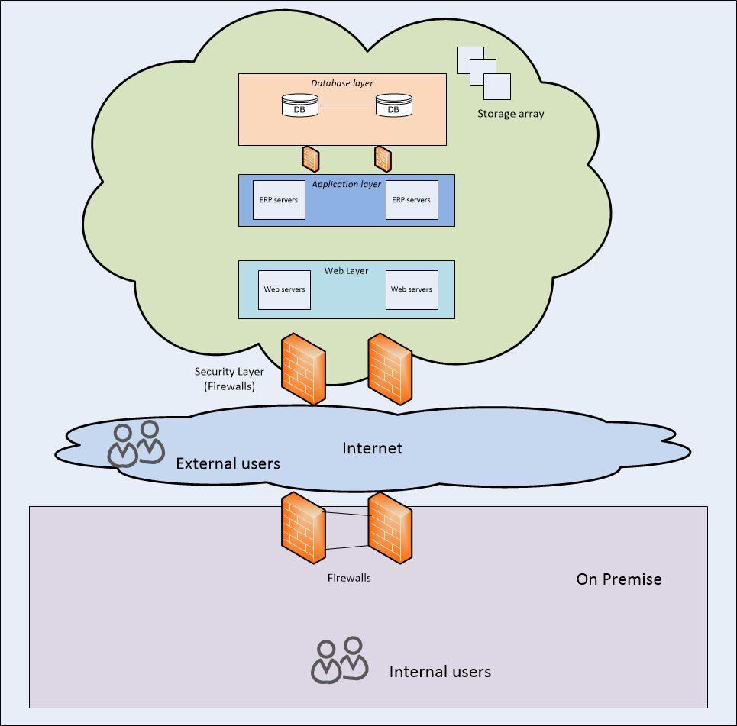
Option 1 : COTS
Advantages
Ability to Flex resourced with demand
Live replication of data
15 min snapshot of data to meet RPO requirement
Multilevel security
Secure access to application from on premise or internet based users.
Ability to be back working within the RTO of 4 hours
Browser based ERP platform access internally and via the internet
Disadvantages
Stable internet connection required, at all times.

Slide 3
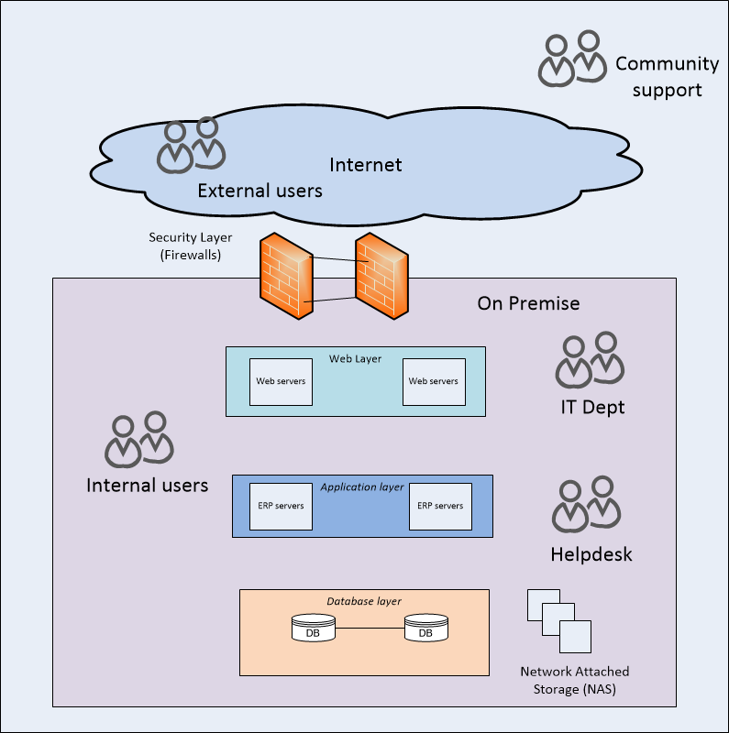
Option 2 : OSS
Advantages
Does not need a stable internet connection for internal users
Over time staff can become proficient in the product
Not locked into a provider contract
Disadvantages
No ability to flex resources with demand
Duplicate hardware required to provide a basic level of resilience and redundancy
RPO and RTO timeframes are subject to hardware and staff abilities and cannot guarantee to meet the business needs
Resilience and redundancy is within a single site
Secure internal access solution would need to be created for external users
Need to learn the solution and how to deploy and support for 150 users
No SLA of KPI for community support
Staff leave and all gained knowledge and experience is lost

Slide 4
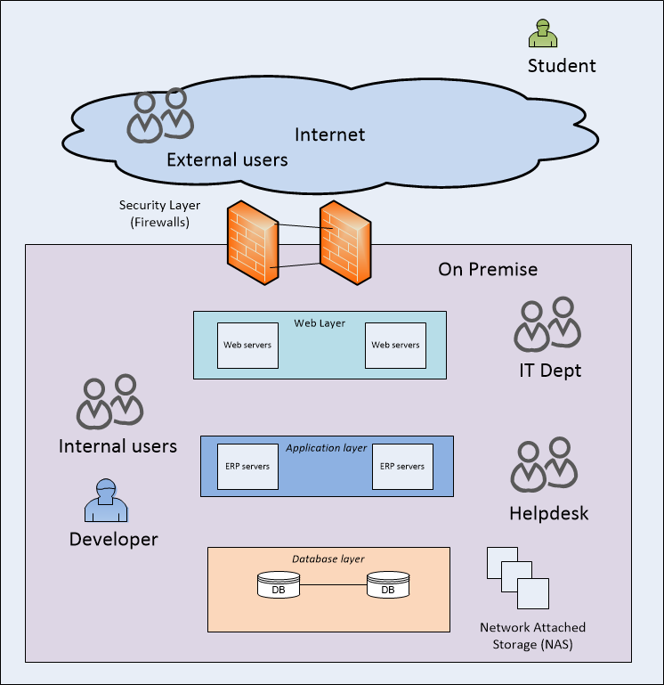
Option 3 : In-House
Advantages
Does not need a stable internet connection for internal users
Over time staff can become proficient in the product
Not locked into a provider contract
Disadvantages
No ability to flex resources with demand
Duplicate hardware required to provide a basic level of resilience and redundancy
RPO and RTO timeframes are subject to hardware and staff abilities and cannot guarantee to meet the business needs
Resilience and redundancy is within a single site
Secure internal access solution would need to be created for external users
Need to learn the solution and how to deploy and support for 150 users
No SLA of KPI for community support
Staff leave and all gained knowledge and experience is lost
Single point of failure in the developer role
Student creator no longer part of the company

Slide 5
Solution choice rationale
Business requirements
Functional Requirements
ERP Platform for 150 staff
Flexibility to manage changes in supply chain and production demand
Non-Functional Requirements
RPO of 15 mins
RTO of 4 hrs
Option 1 (COTS) is the only solution that will provide SLA and KPI’s to meet the business requirements
Both option 2 and 3 will cost more annually once the extra hardware cost and internal support cost is taken into consideration.
There are multiple security and support issues with option 2 and 3
Community support – no security against malicious actors giving ‘advice’.
Community support - no SLA or KPI’s
Student created – student not a part of the company
Developer – single point of failure
Recommendations:
Review business requirements of RPO and RTO metrics

